Slide 1
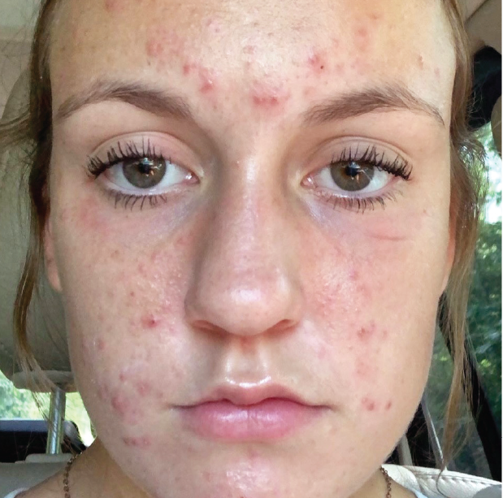
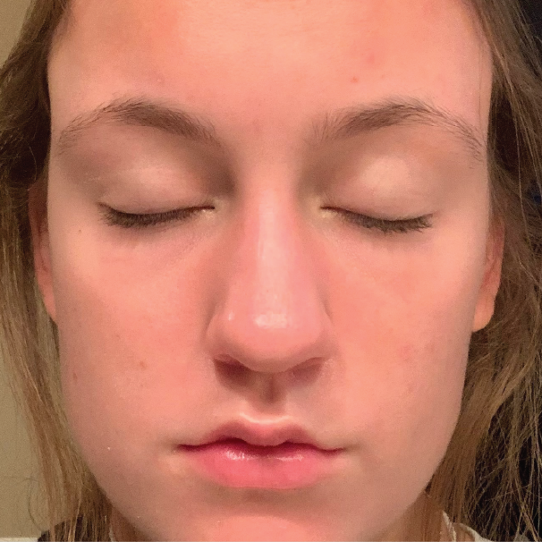
BEFORE / AFTER | 5 months post 8 tx | courtesy of Theresa Reynolds Practical Nurse & Laser Provider
Forever Clear BBL ® 420 nm, 6 j/cm², 200 ms, 20 ˚C, 15 x15, 3 passes; 560 nm, 8 j/cm², 20 ms, 20 ˚C, 11 mm, 2 passes; 590 nm, 10 j/cm², 15 ms, 25 ˚C, 2 minutes each cheek
1
©2023 Sciton, Inc. All rights reserved. 2600-050-05 Rev. A B&A Forever Clear BBL

